Slide 1
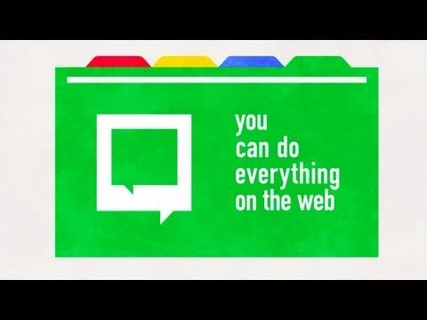
Chromebook Student User guide
John G Borden Middle School
Wait a second. What's a Chromebook?
Chromebook

Slide 2
Taking Care of your Chromebook
Students are responsible for the general care of the Chromebook.
  Chromebooks that are broken, or fail to work properly, must be taken to our in-school Technology Help Desk.
Do not take district owned Chromebook to an outside computer service for any type of repairs or maintenance.

Slide 3
Why a 1:1 Chromebook initiative?
We believe that every student should have equal access to technology both inside and outside of school.
Chromebooks are more portable than carrying multiple textbooks and binders to and from school.
Documents stored on the cloud (in Microsoft Office 365) are less likely to be lost or destroyed than paper documents.
Student management systems such as Schoology allow students a better ability to manage their classwork and homework in an environment accessible 24/7.

Slide 4
Taking Care of your chromebook
General precautions:
  No food or drink is allowed next to your Chromebook.
  Heavy objects should never be placed on top of your Chromebook.
  Chromebooks should never be left in a car, unlocked locker or any unsupervised area.
  Students are responsible for bringing completely charged Chromebooks for use each school day.
Carrying Chromebooks:
  Never move a Chromebook by lifting from the screen.
  Always support a Chromebook from its bottom with lid closed.
  Never transport your Chromebook with the power cord plugged in.

Slide 5
Taking care of your chromebook
Screen Care:
  The Chromebook screens can be easily damaged.
  The screens are particularly sensitive to damage from excessive pressure on the screen.
  Do not poke the screen with anything that will mark or scratch the screen surface.
  Do not place anything on the keyboard before closing the lid.
  Clean screen with a soft, dry microfiber cloth or anti-static cloth.
Protective Case:
  It is expected that students keep the school issued protective case on their device at all times.

Slide 6
Using your Chromebook at school
Chromebooks should be locked in lockers when not in use

Slide 7
Using your Chromebook at school
Remember to bring your charged Chromebook to school every day!
  If a Chromebook is left at home, we have a limited number of devices to loan to students just for the school day.
    Loaned Chromebooks must be returned before leaving school at the end of the day.
    Repeat violations may result in disciplinary action.

Slide 8
Using your Chromebook at School
Backgrounds
Printing
Inappropriate media may not be used as a screensaver or background.
Presence of guns, weapons, pornographic materials, inappropriate language, alcohol, drug, and gang related symbols or pictures will result in disciplinary actions.
Digital sharing of documents is encouraged between students and teachers.
Printing is not permitted.

Slide 9
At Home Use
The use of Chromebooks at home is encouraged in grades 7-8

Slide 10
At Home Use
Students are allowed to connect to a wireless network when using their Chromebook away from school.
  Students use of Chromebooks will be subject to the WCSD website filtering software even when accessing materials on a home connection.
  The filtering software will only affect WCSD owned devices and its use under the district’s Acceptable Computer and Internet Use Policy.

Slide 11
Managing your Files and Saving Your Digital Work
All student work will be stored in Internet/cloud based applications.
Student work can be accessed from any computer with an Internet connection and most mobile Internet devices.
Students should always save frequently when working on digital media.
The district will not be responsible for the loss of any student work.

Slide 12
Chromebooks left in Unsupervised Areas
Under no circumstances should Chromebooks be left in an unsupervised area.
  Unsupervised areas include the school grounds, the cafeteria, gymnasiums, locker rooms, and hallways, etc…
Chromebooks left in these areas are in danger of being stolen.
If an unsupervised Chromebook is found, notify a staff member immediately.

Slide 13
Thank you for viewing this presentation.

